Slide 1

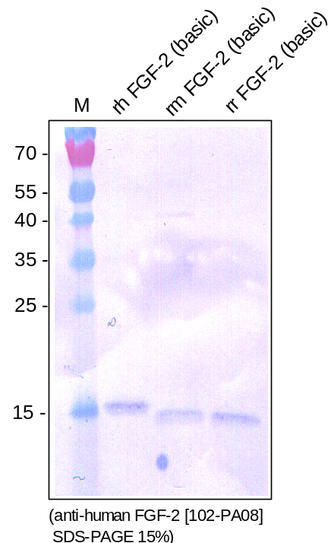
ReliaTech GmbH
Rabbit anti-human FGF-2 (basic)
(Cat #102-PA08)
Figure 1. Western analysis of recombinant human (RT# 300-003), mouse (RT# M30-015) and rat (RT# R20-060) FGF-2 (basic) using a polyclonal antibody directed against recombinant human FGF-2. As expected the antibody cross reacts with the mouse and rat proteins.
http://www.reliatech.de / orders@reliatech.de

